Slide 1

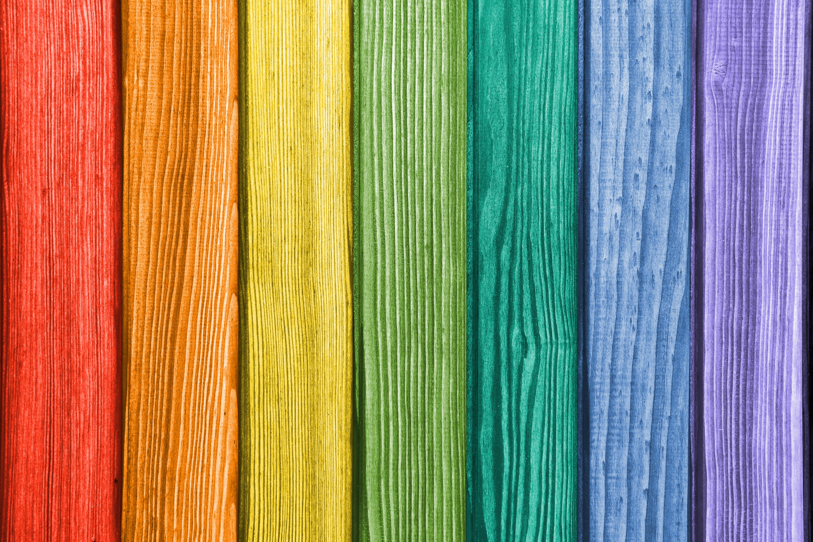


Uses of every day materials
For parents
Thank you for supporting your child’s learning in science.
Before the session:
There are 5 main activities. They do not have to be done on the same day. In fact, to support your child’s attention levels, each activity has been broken down into 20-40 minute chunks so could be used over 5 days.
Please read the slides to know which activity to do, what your child is learning and what you need to get ready.
The activities are hands on. Take photographs so that learning can be shared and discussed.
During the session:
Share the learning intentions on slide 2.
Slide 9 has a glossary of key terms.
Reviewing with your child:
Slides 4-8 give examples of what your child may produce.
Classify objects by material and
property to suit a specific purpose
Year 2
Ages 6-7

Slide 2
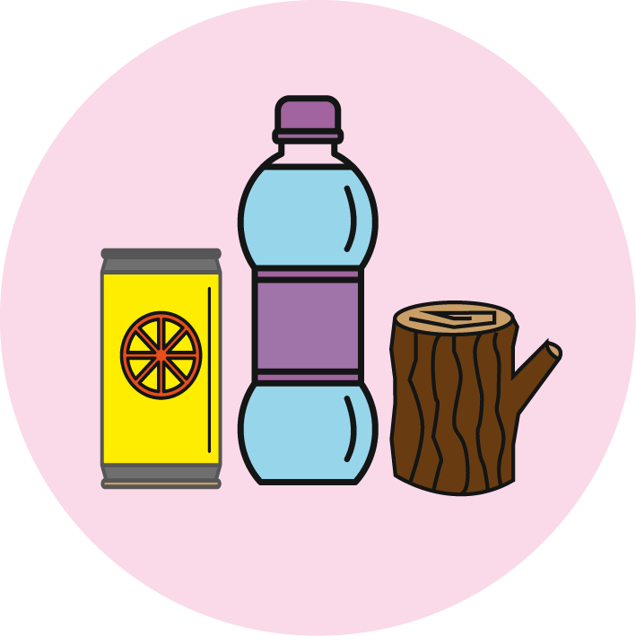
Uses of every day materials
Logo for section to sit inside roundel
What are the objects in the home made of and what are their properties?
Key Learning
All objects are made of one or more materials that are chosen specifically because they have suitable properties for the task.
For example, a water bottle is made of plastic because it is transparent allowing you to see the drink inside and waterproof so that it holds the water.
When choosing what to make an object from, the properties needed are compared with the properties of the possible materials, identified through simple tests and classifying activities.
A material can be suitable for different purposes and an object can be made of different materials.
Activities
Activity 1- Identify materials and their properties.
Activity 2- Look at the materials an object is made of and discuss its purpose.
Activity 3- Identify what materials are best for a certain purpose.
Activity 4- How are materials used to fit a purpose?
Activity 5- Create a design using suitable materials.
Practical investigation
You will need: materials from around the house for your design or paper and pencil to draw your ideas.
I can…
Identify and compare the suitability of a variety of everyday materials, including wood, metal, plastic, glass, brick, rock, paper and cardboard for particular uses.
2

Slide 3
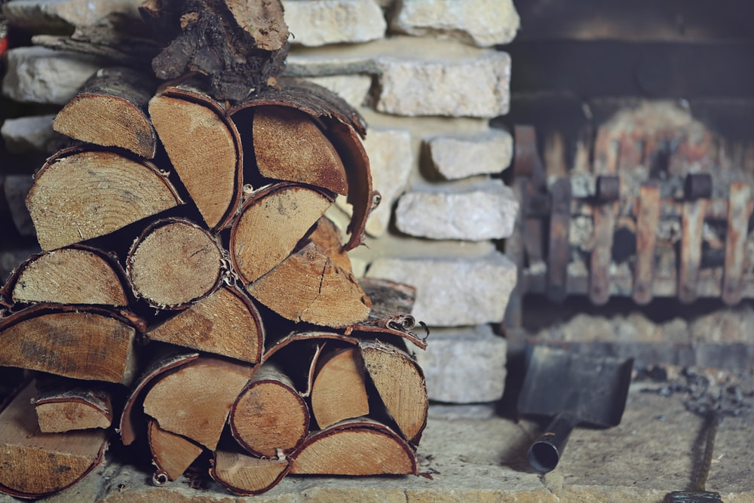
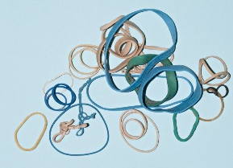
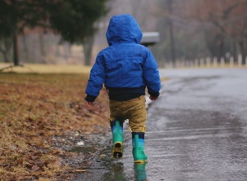
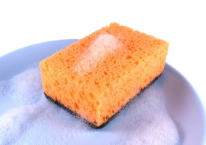
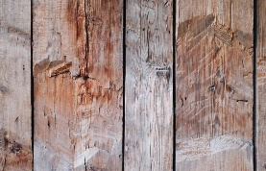
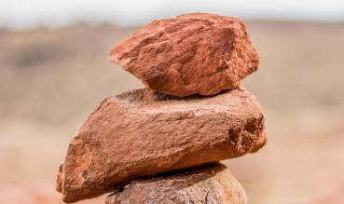


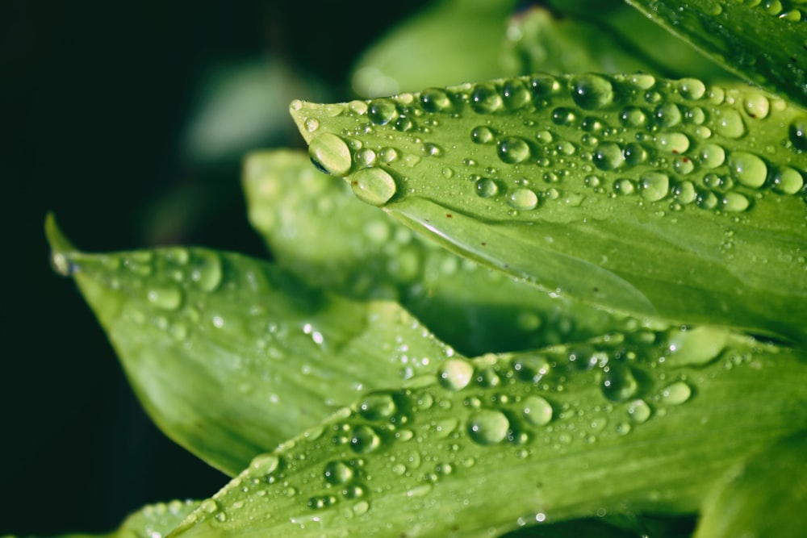
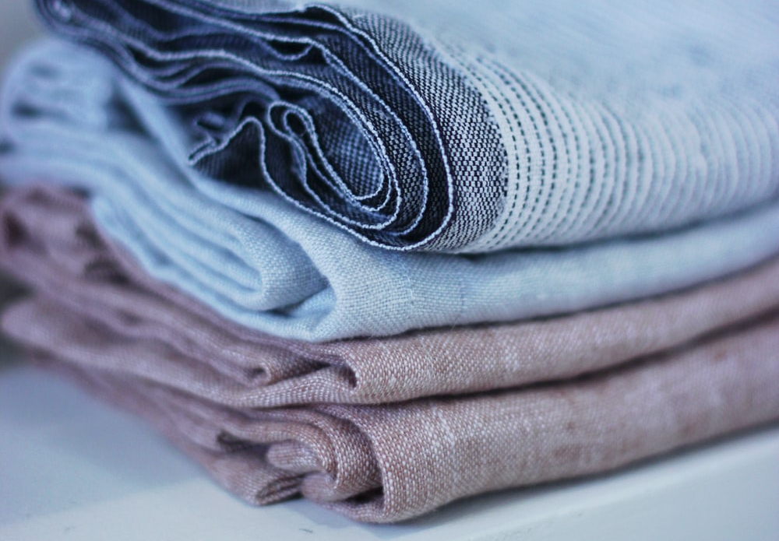
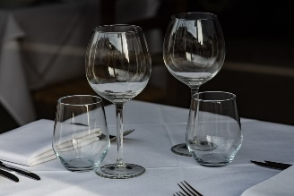

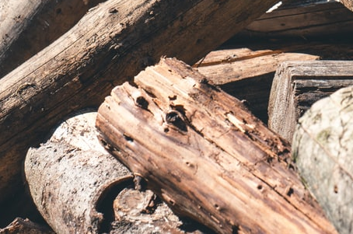
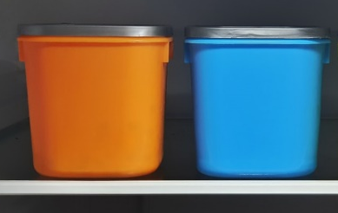

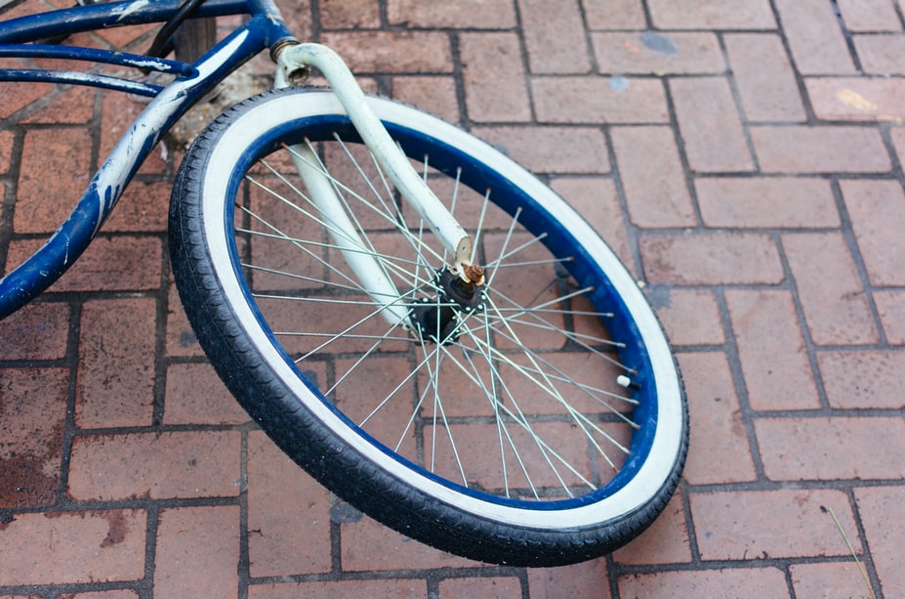
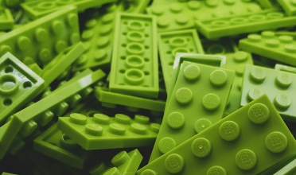
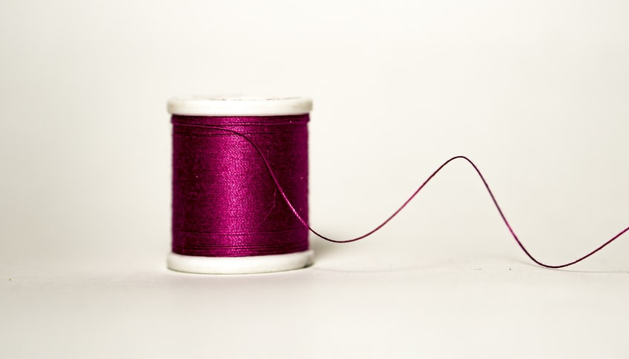
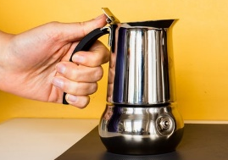
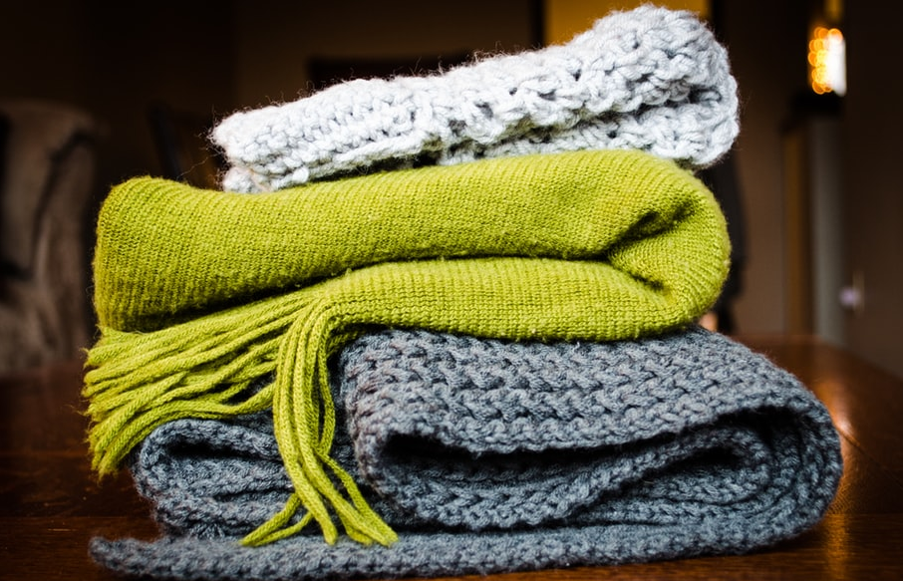
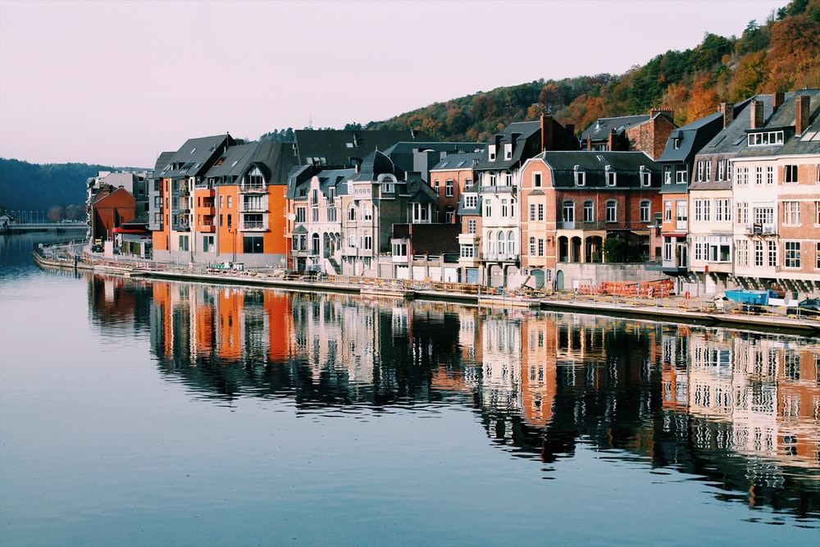
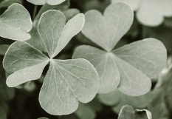
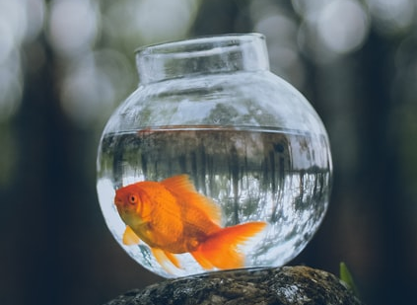
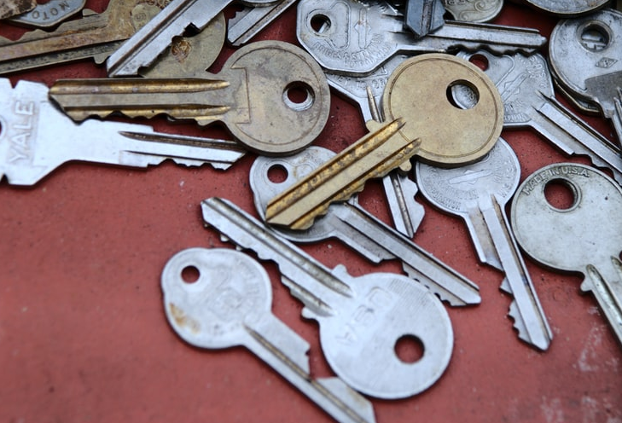
Look at these key words and explain what they mean. (10 minutes)
materials
stretchy
waterproof
absorbent
wood
rock
water
rigid
not absorbent
fabric
glass
translucent
flexible
rough
smooth
opaque
rubber
plastic
hard
soft
reflective
dull
transparent
metal
3
Pay close attention to the words in blue as the vocabulary has progressed since year 1.

Slide 4
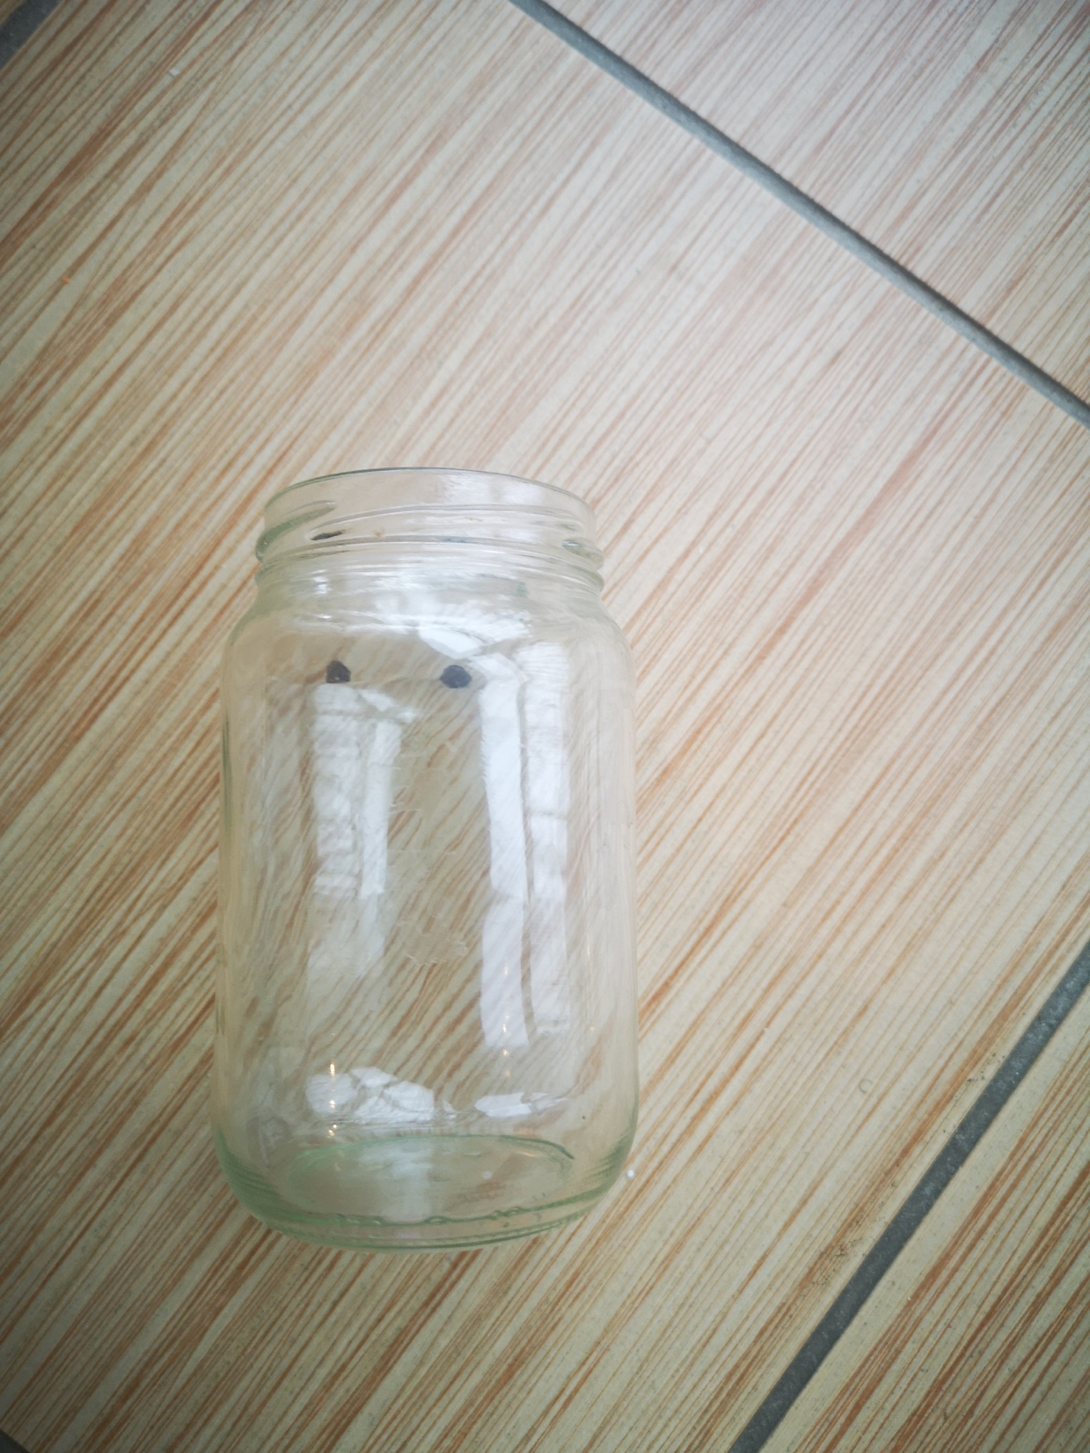
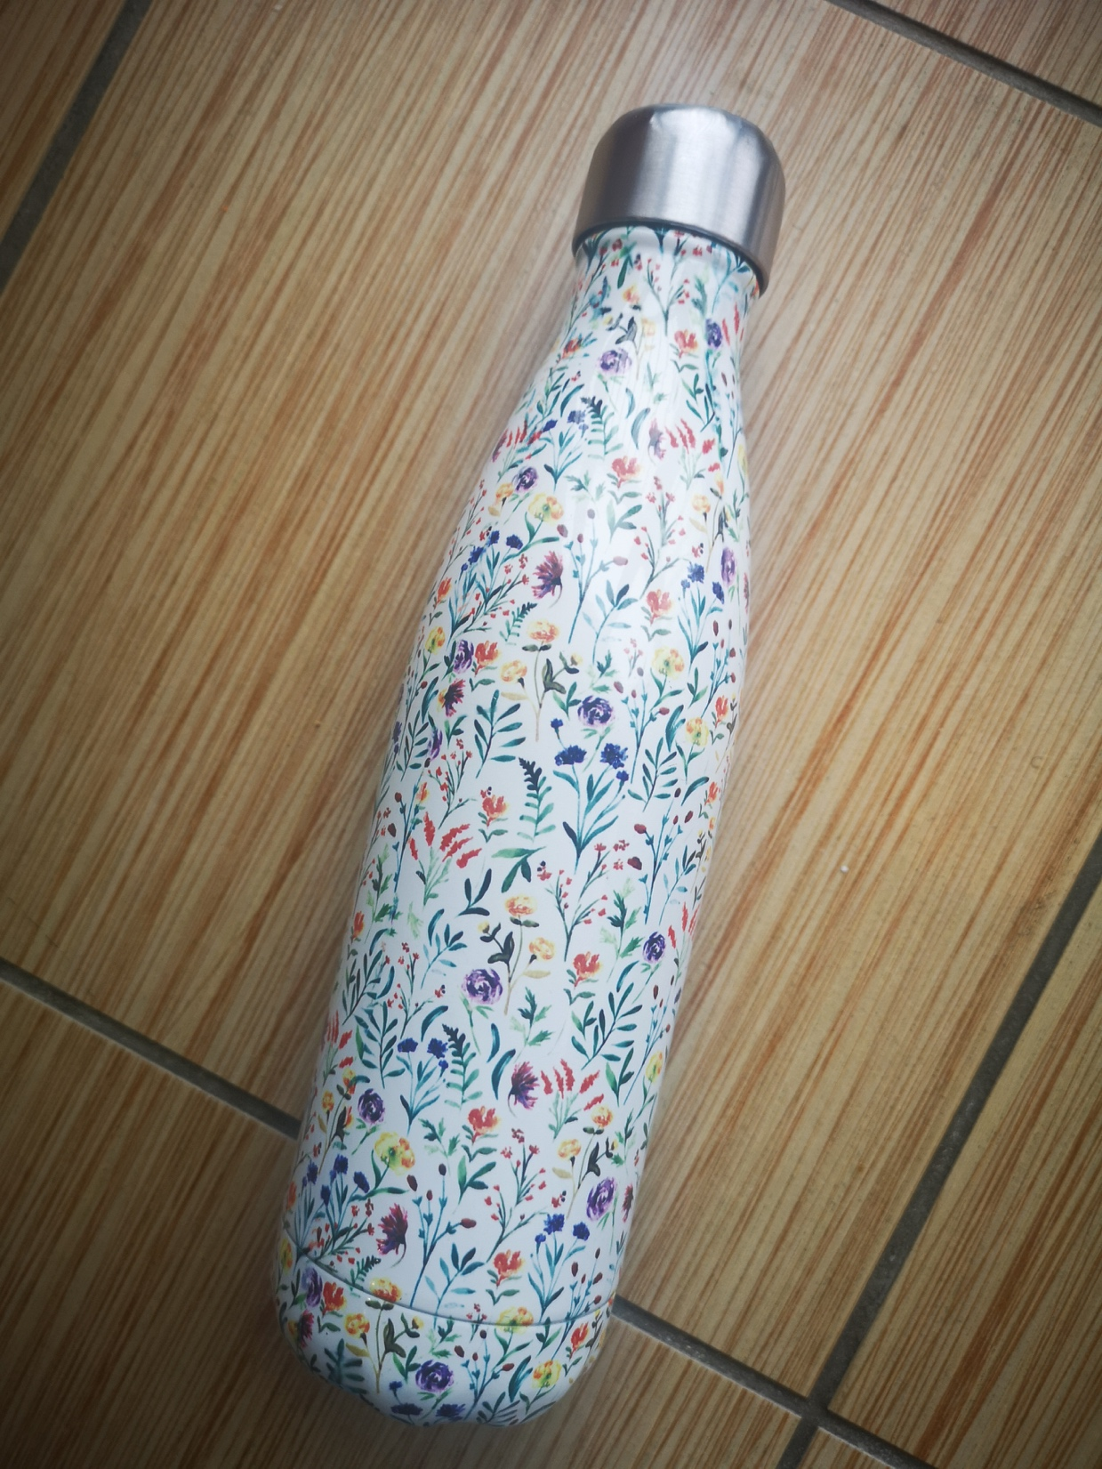
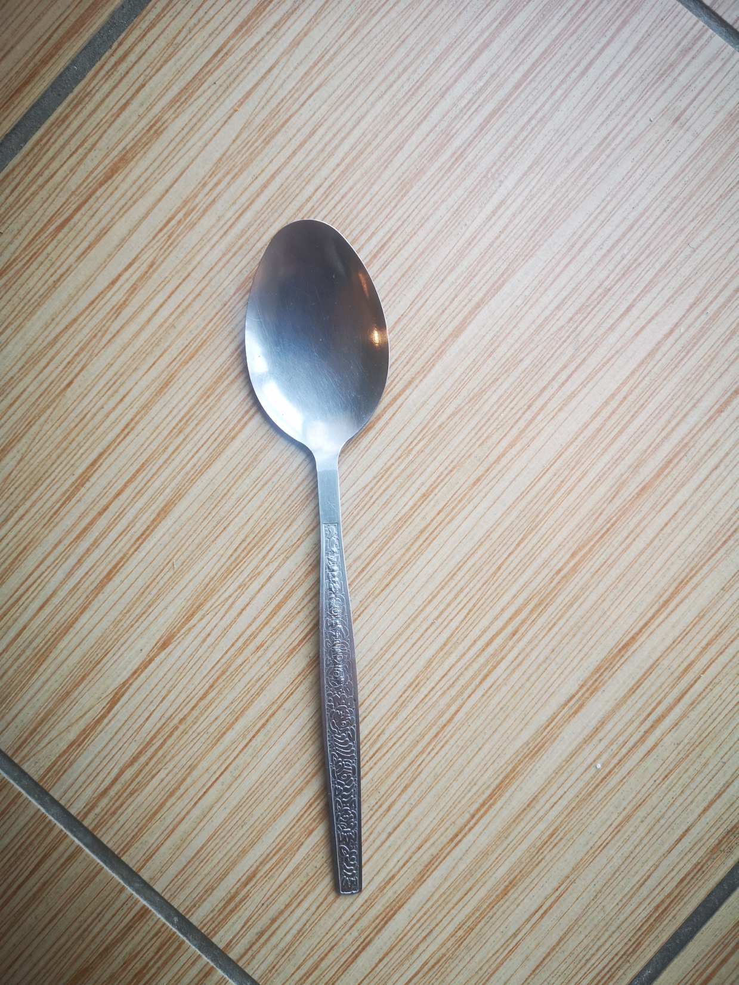
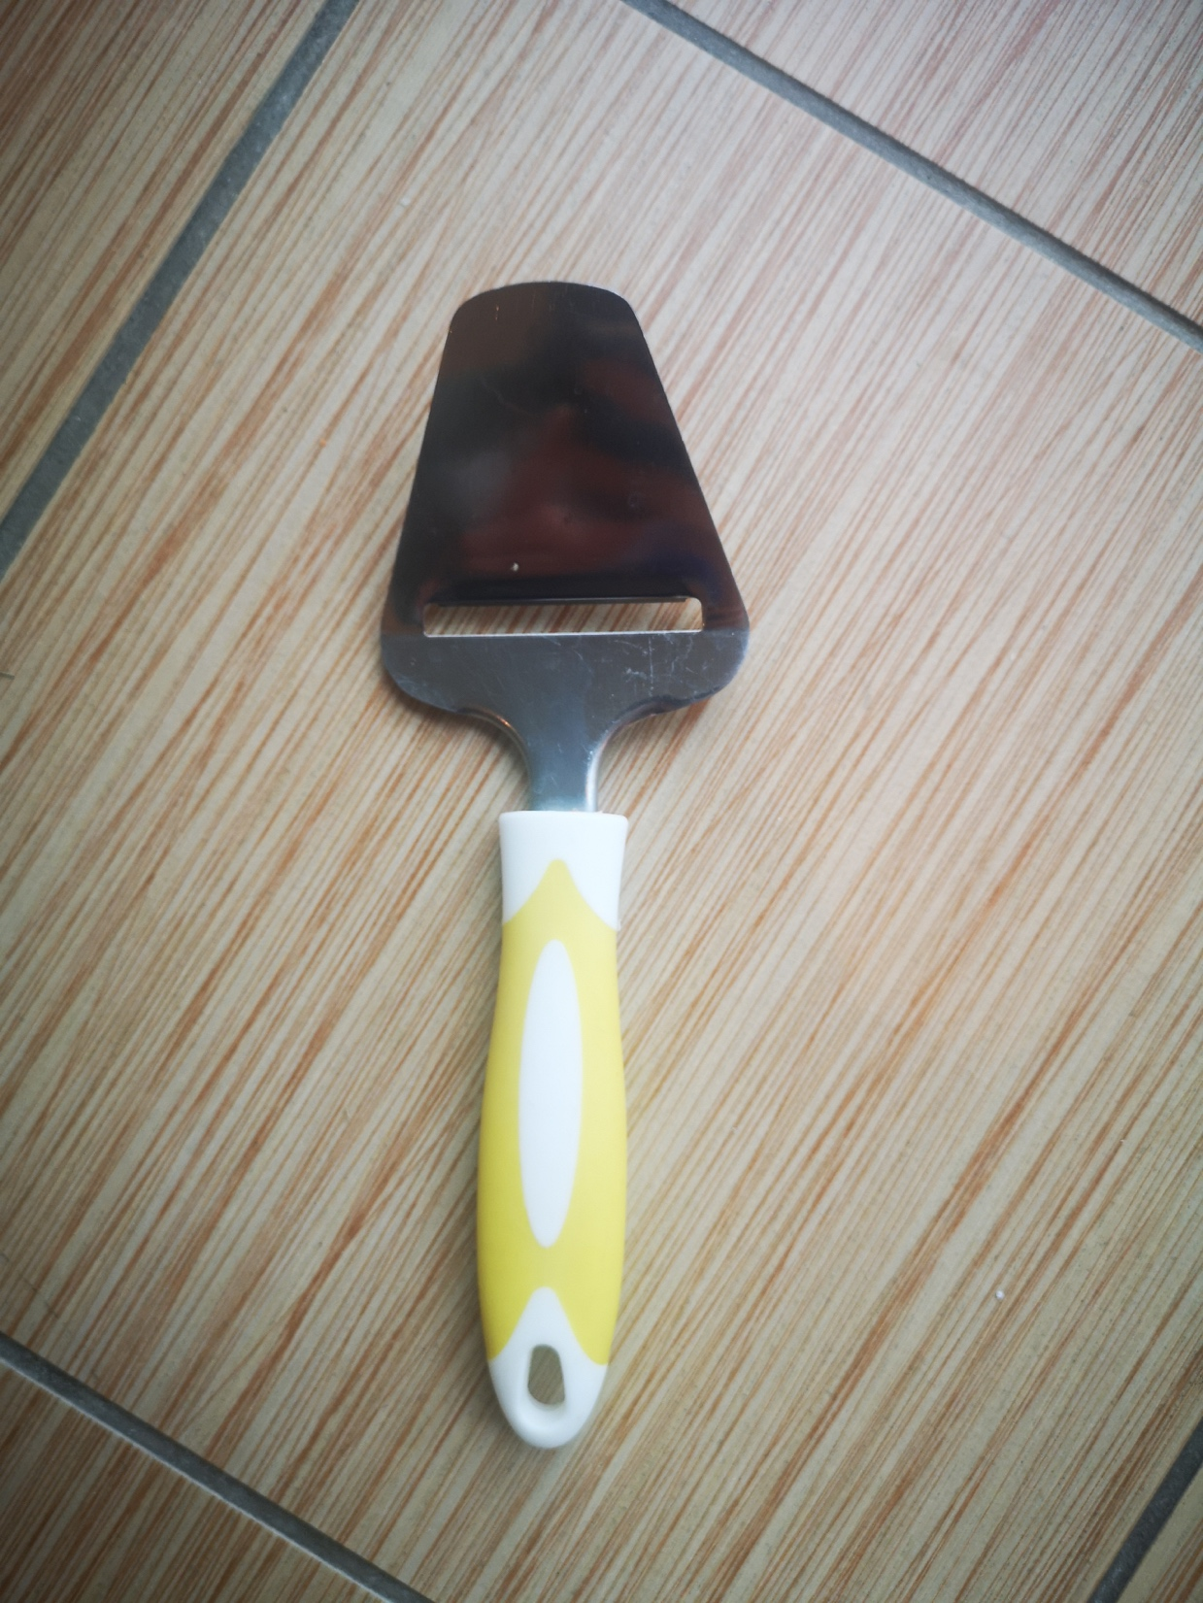
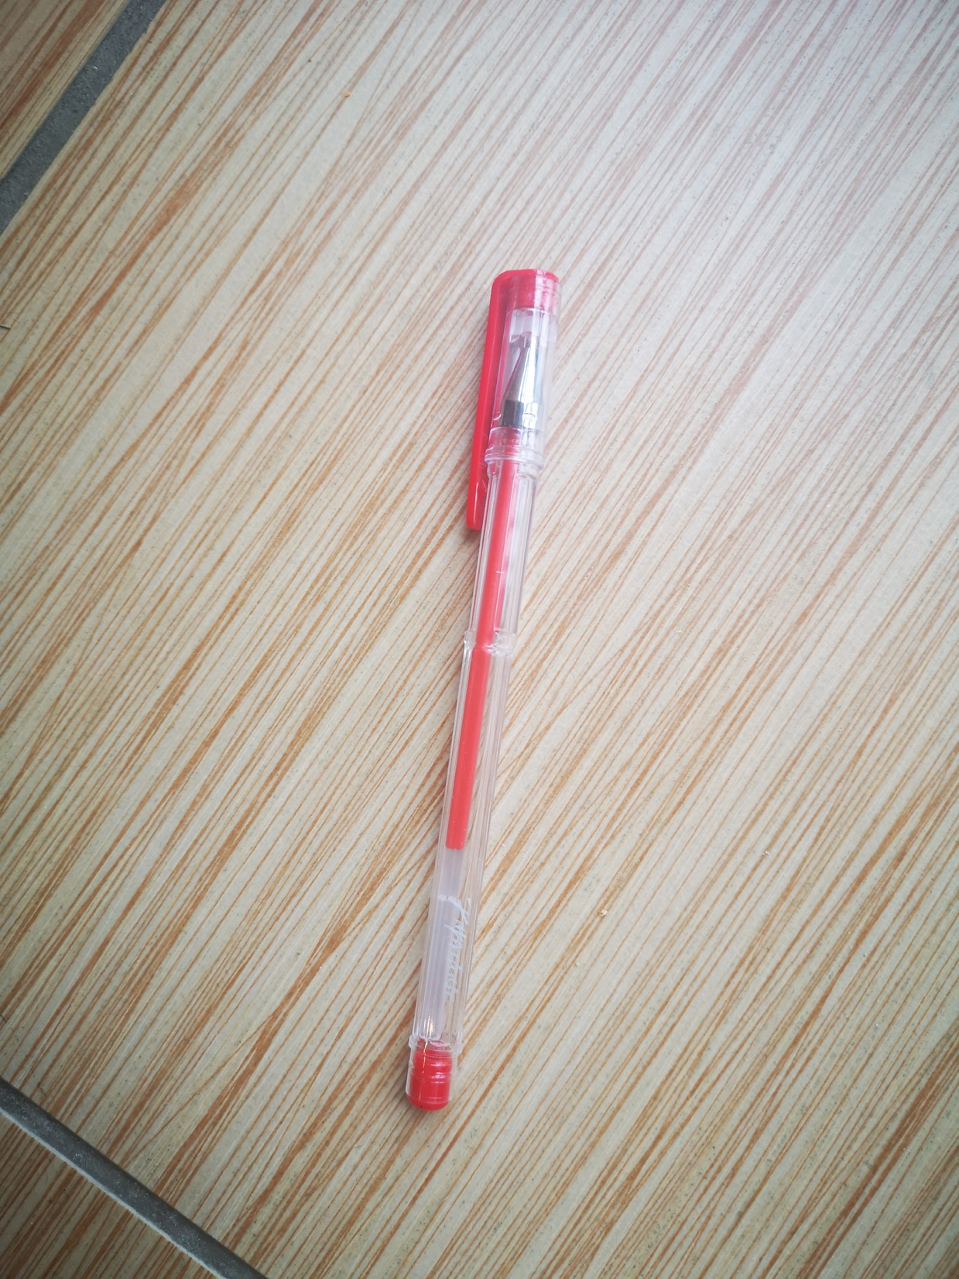
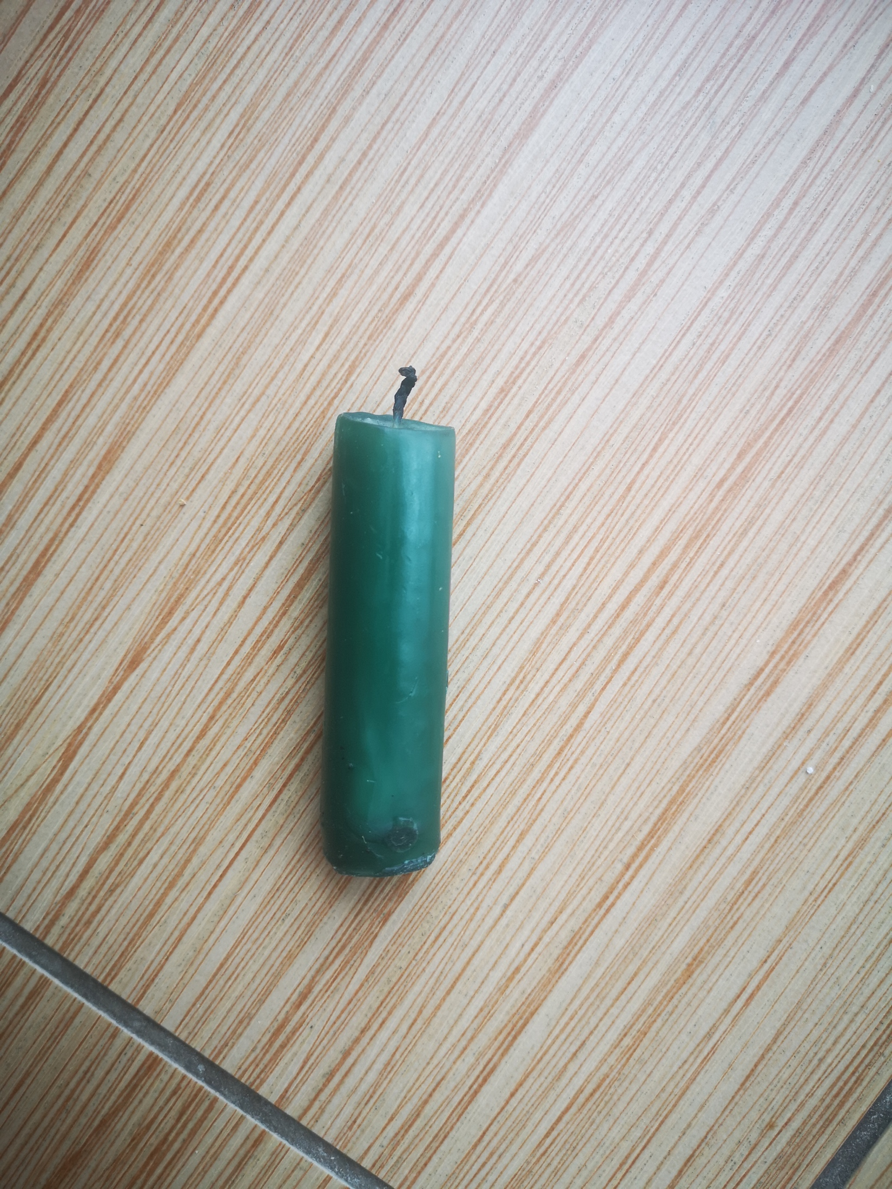
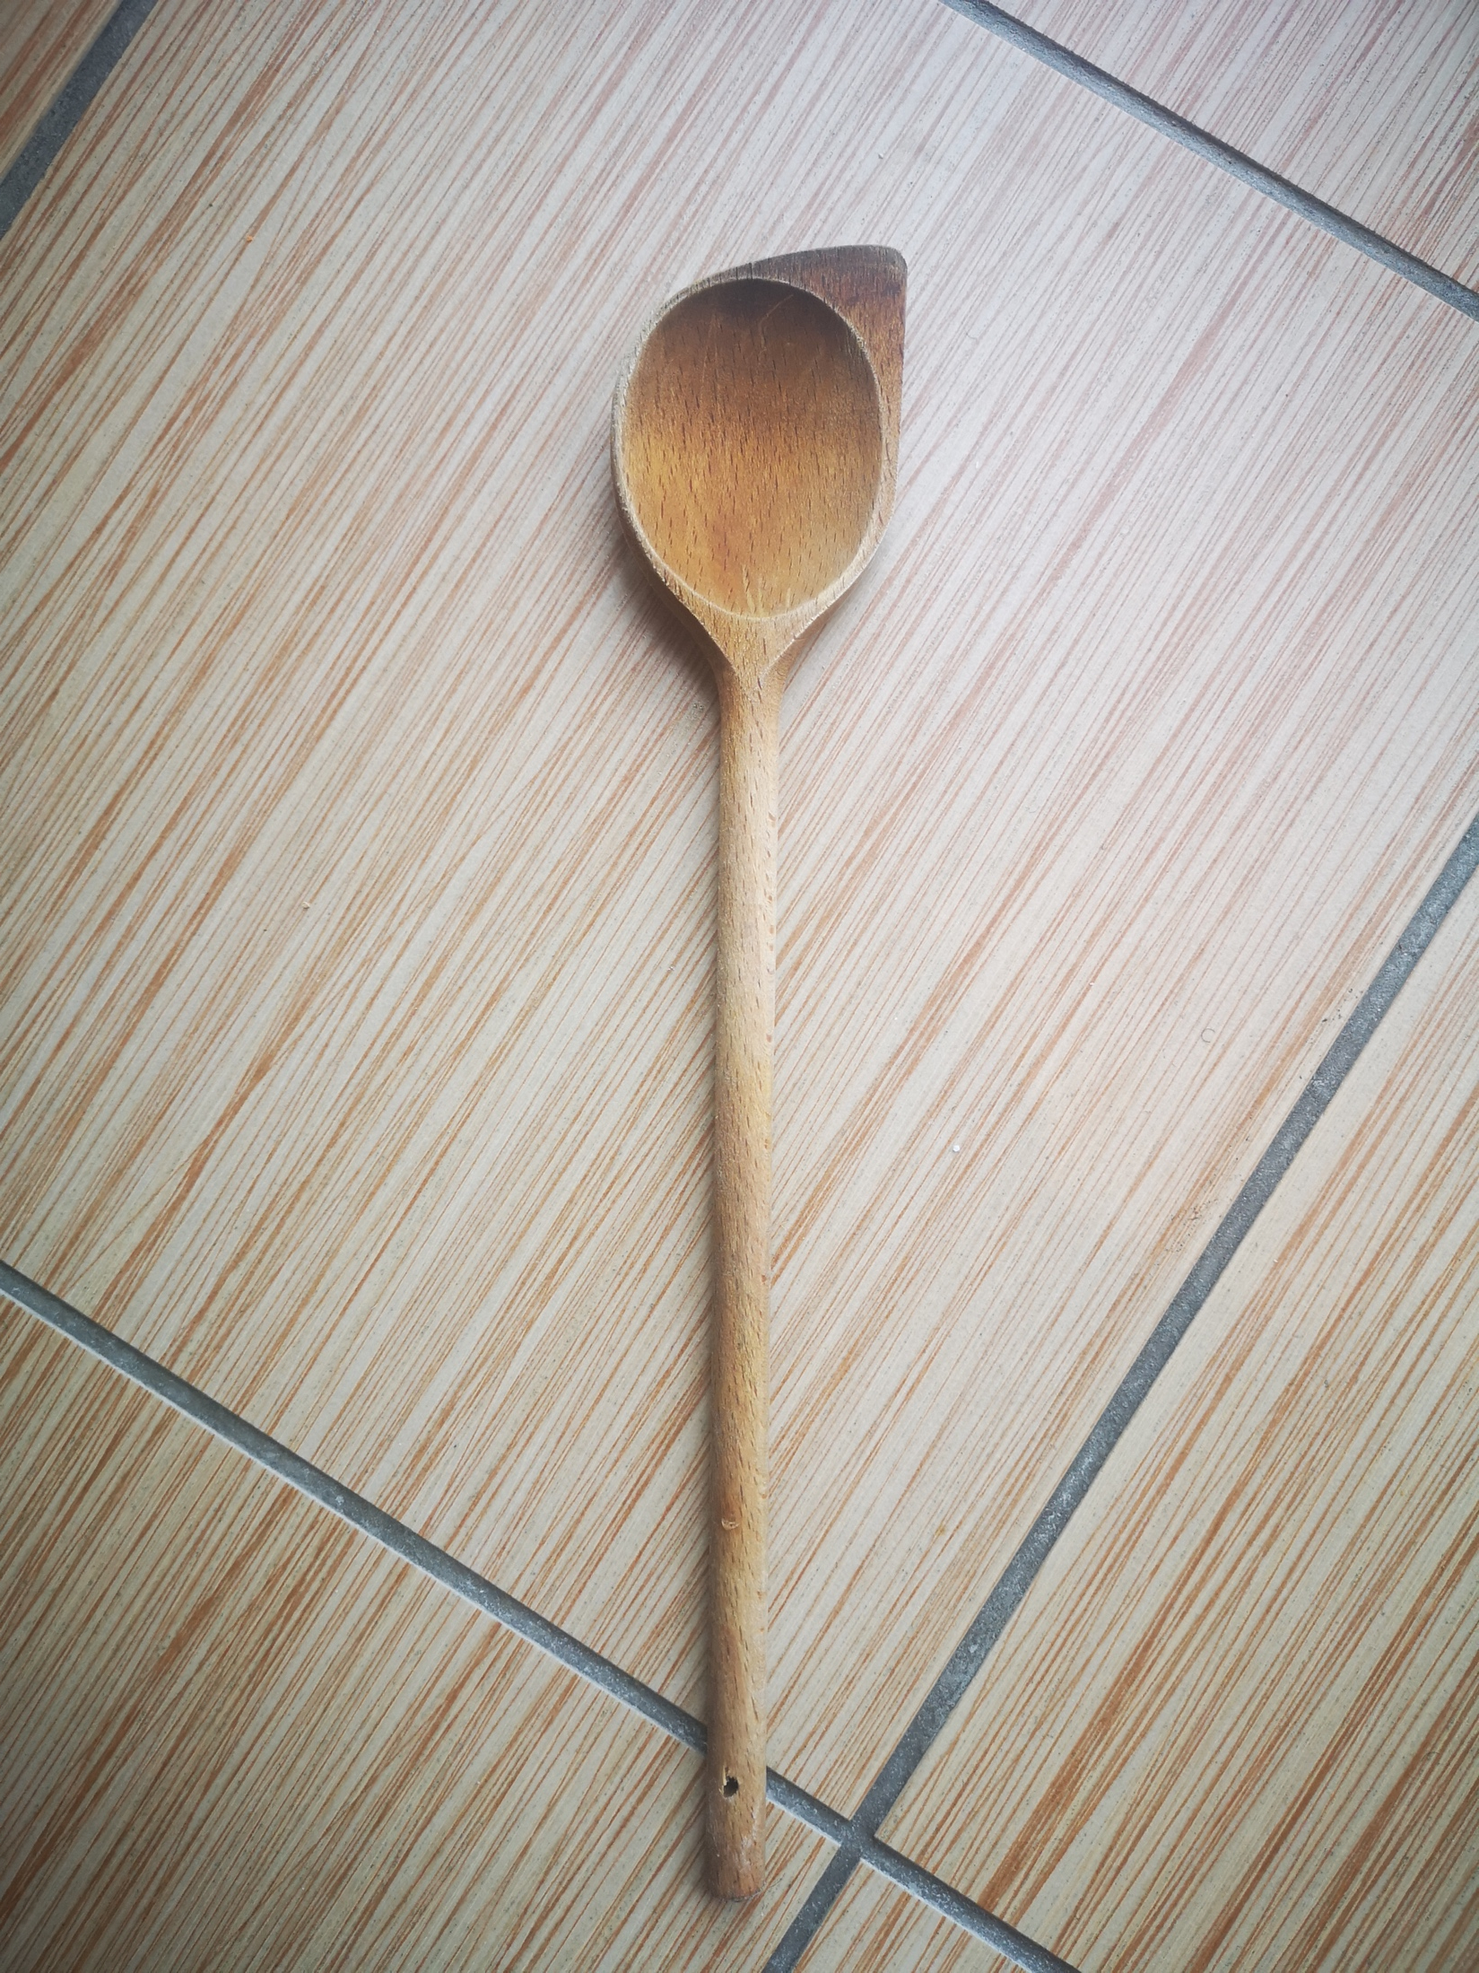
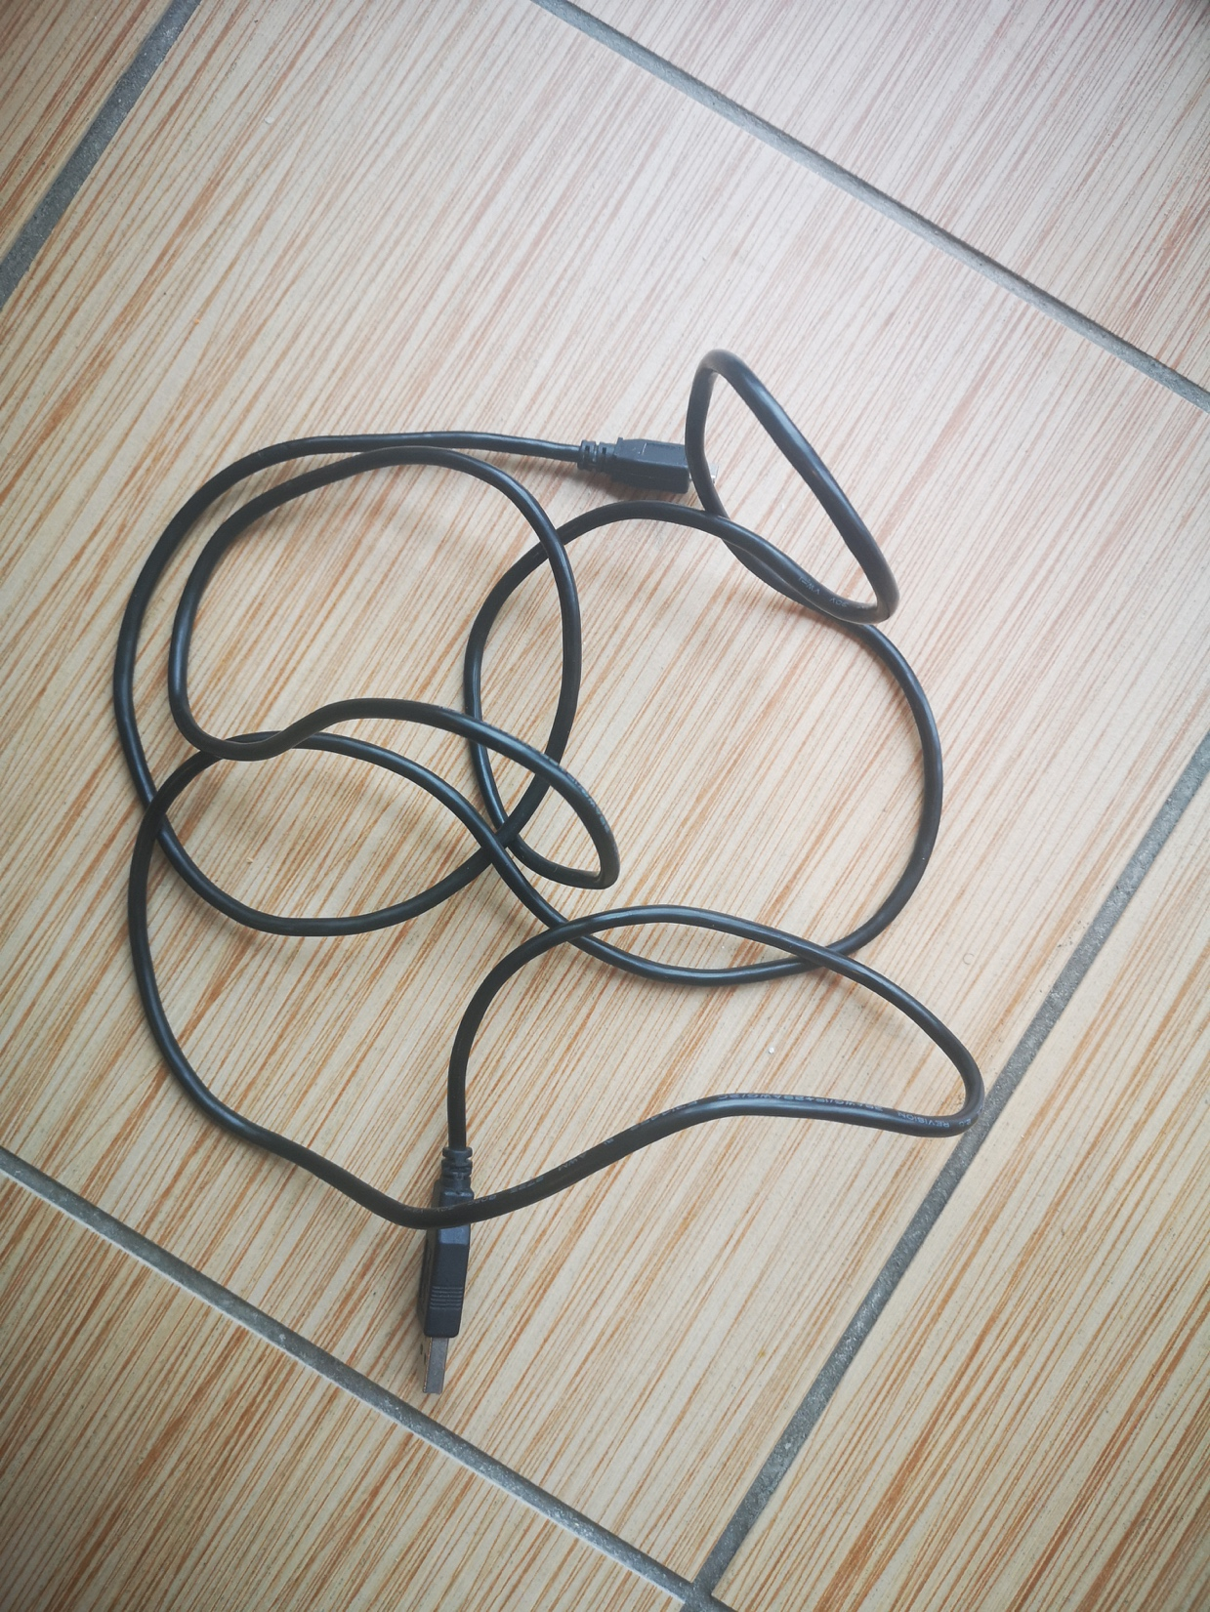
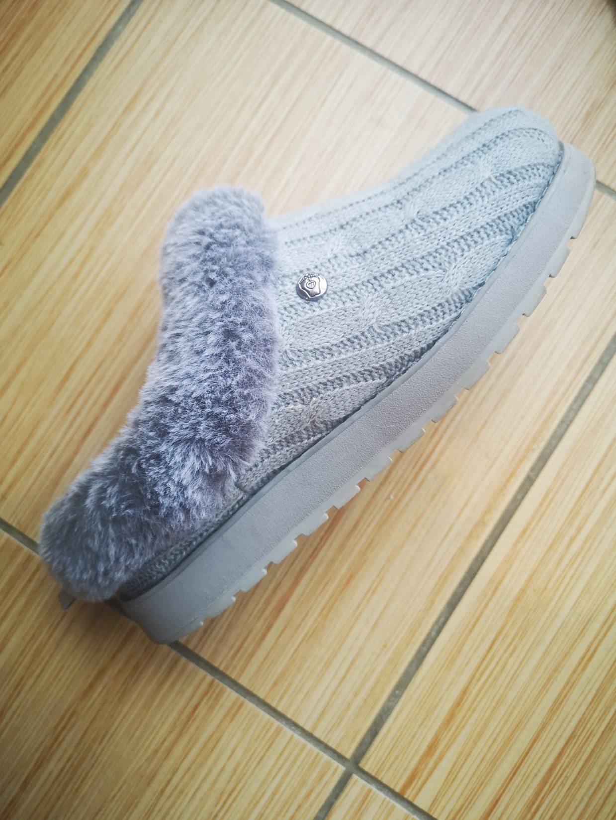
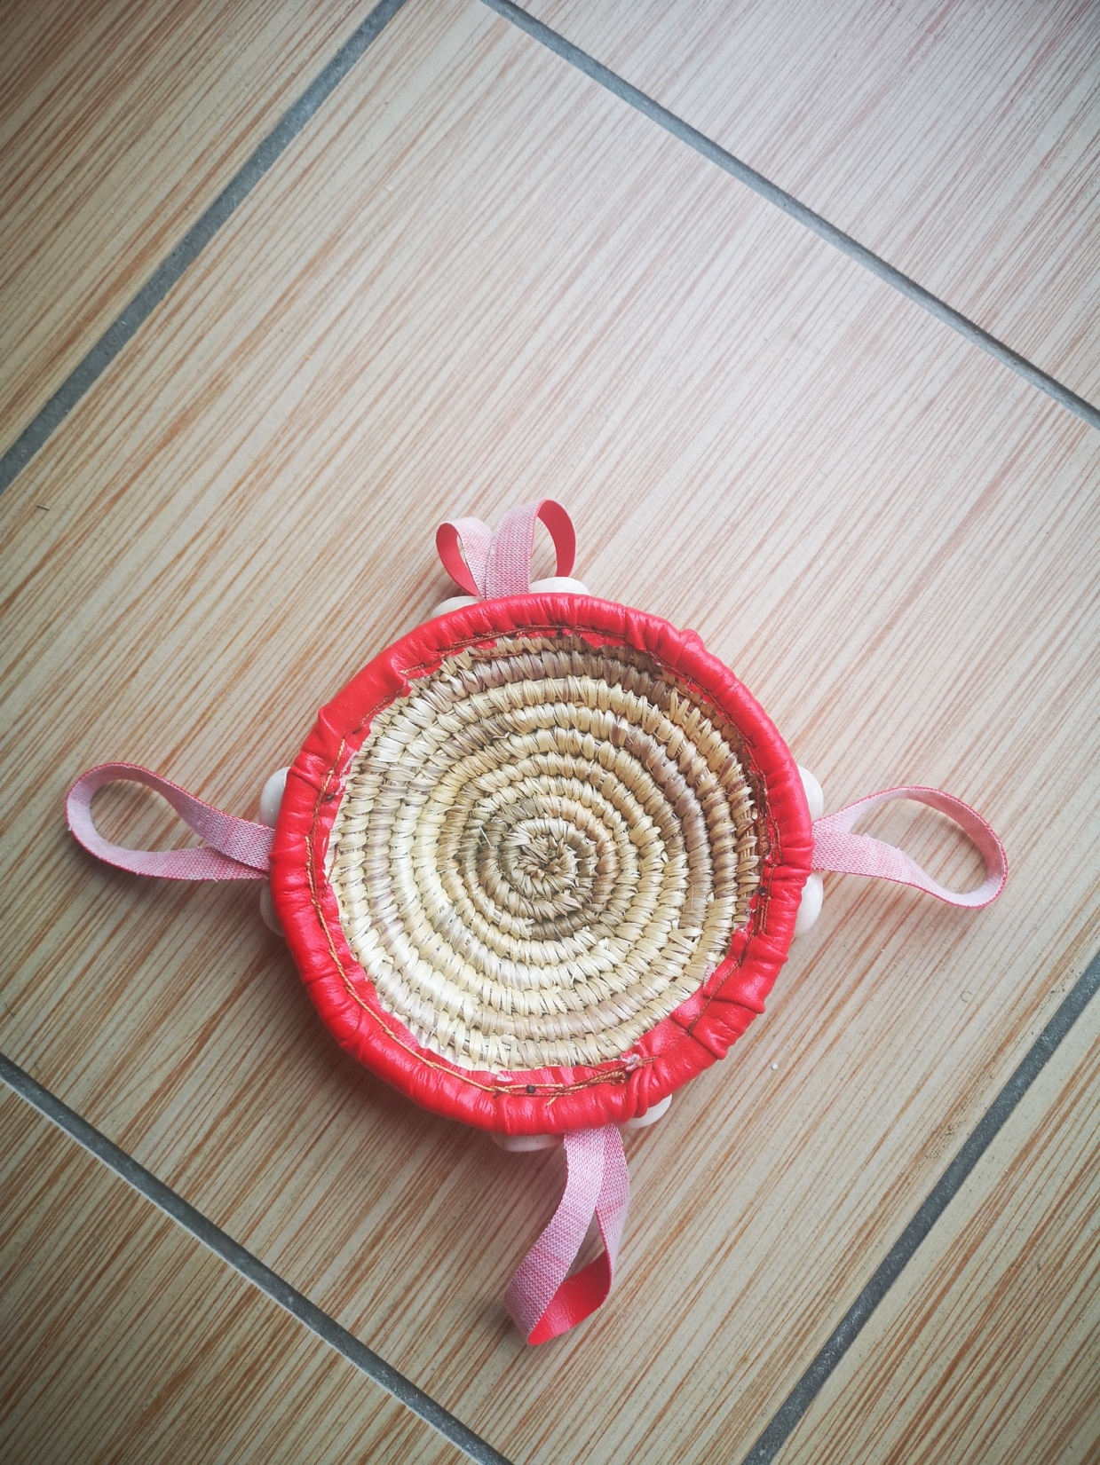
Explore, think, talk….
Logo for section to sit inside roundel
What do the children already know about materials and their properties? (20 minutes)
Activity 1:
Once your child feels confident with the vocabulary, ask them to find between 5-10 objects around the house. Challenge them to match the blue words on the list.
Vocabulary to listen out for:
Following on from year 1:
Plastic, rock, metal, glass, wood, water, clay, hard, soft, stretchy, floppy, waterproof, absorbent, breaks/tears, rough, smooth, dull
Year 2 transition of vocabulary:
rigid (stiff), flexible (bendy), reflective (shiny), transparent (see-through), opaque (not see-through), translucent (a little bit see-through)
Learning outcome: I can identify materials and their properties.
Rigid
Sort the objects collected into two groups. Do this 4-5 times using the word mat to help you.
Flexible
4

Slide 5
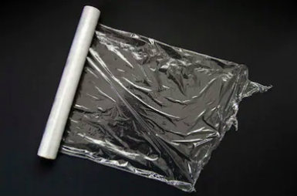
Explore, talk, extend
Logo for section to sit inside roundel
Look at the materials an object is made from and discuss what it is used for.
(20 minutes)
Activity 2:
e.g. Cling film
I found cling film.
It is made of plastic.
It is flexible and transparent.
It is used to wrap around food to keep it fresh.
It is useful because it is flexible enough to wrap around different shapes.
Because it is transparent, I can easily see what food I have wrapped up.
Let your child have a go using the sentence starters to structure their discussion.
I found ________.
It is made of ________ (and______).
It is ______________ (properties).
It is used to/for_____________.
It is useful because ______________.
5

Slide 6
Activity 3:
(10-15 minutes)
Ask your child what other materials could be used to wrap food:
“Could I use wood, metal, water, rock etc?”
Choose one of the objects your child found and ask the same questions.
Note:
Asking ‘silly’ questions like: “I will wrap my sandwich using brick” will not only make your child laugh, but help them to reason for or against a suitable or unsuitable idea.
Learning outcome: I can identify what materials are best for a certain purpose.
Your child may say no to metal - refer to tin foil
6

Slide 7
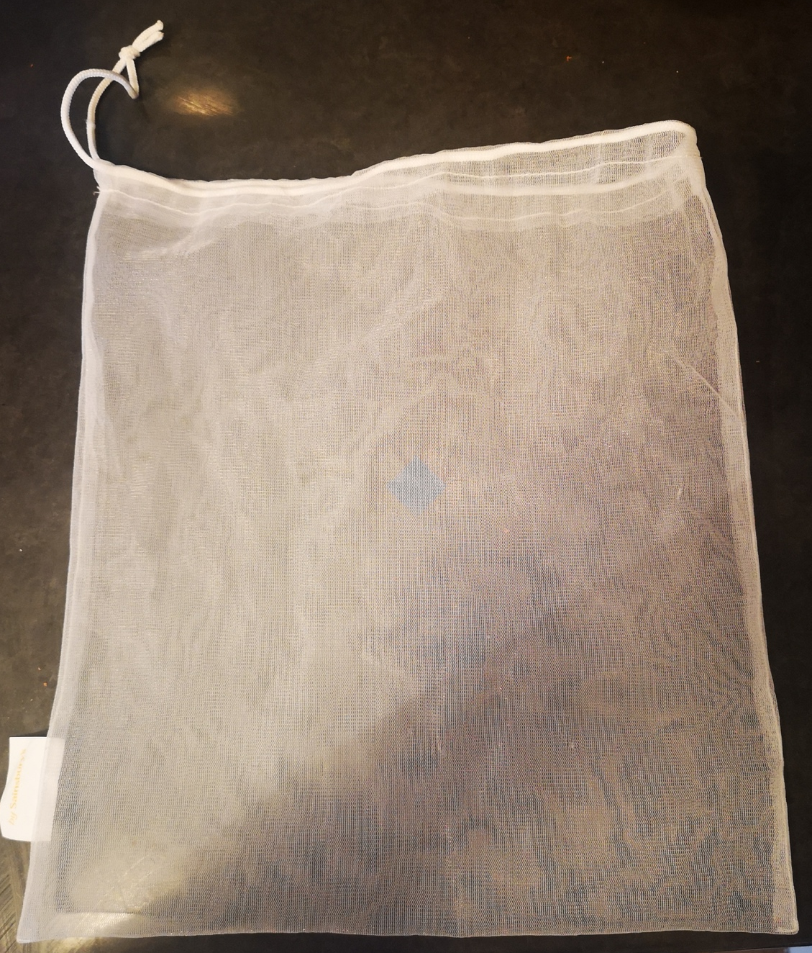
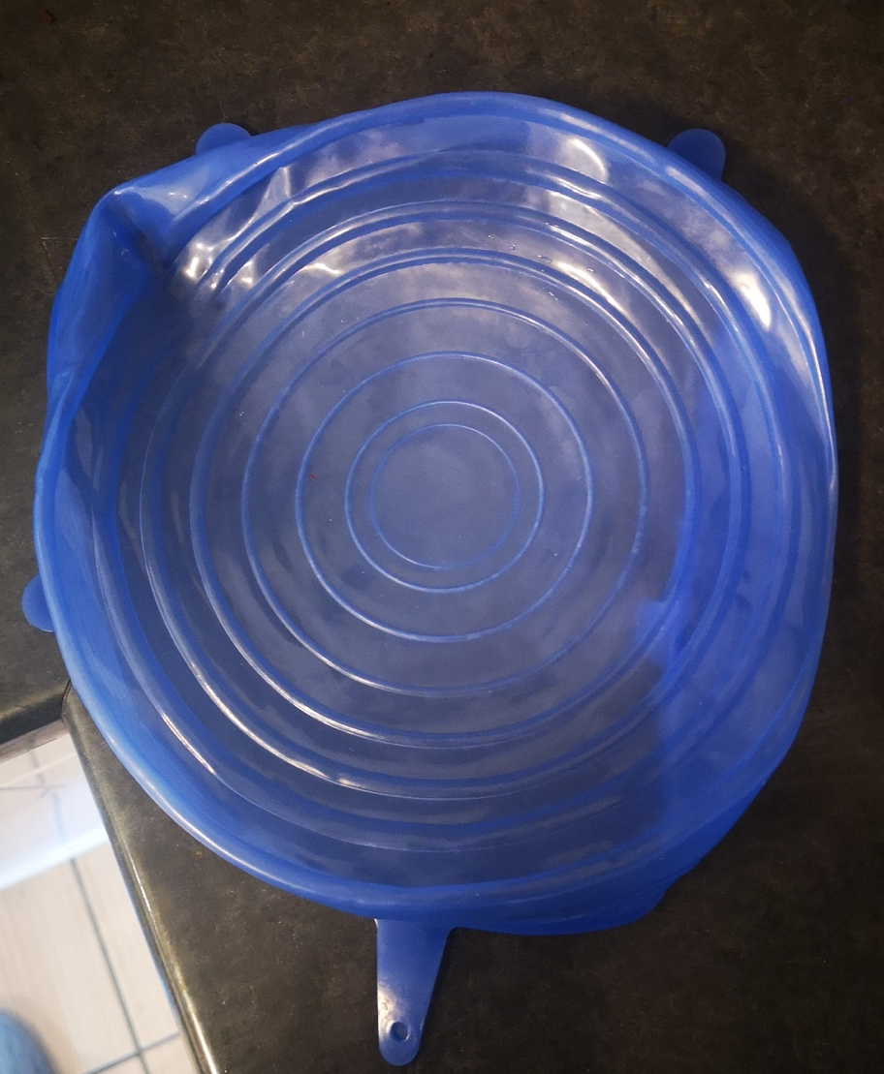
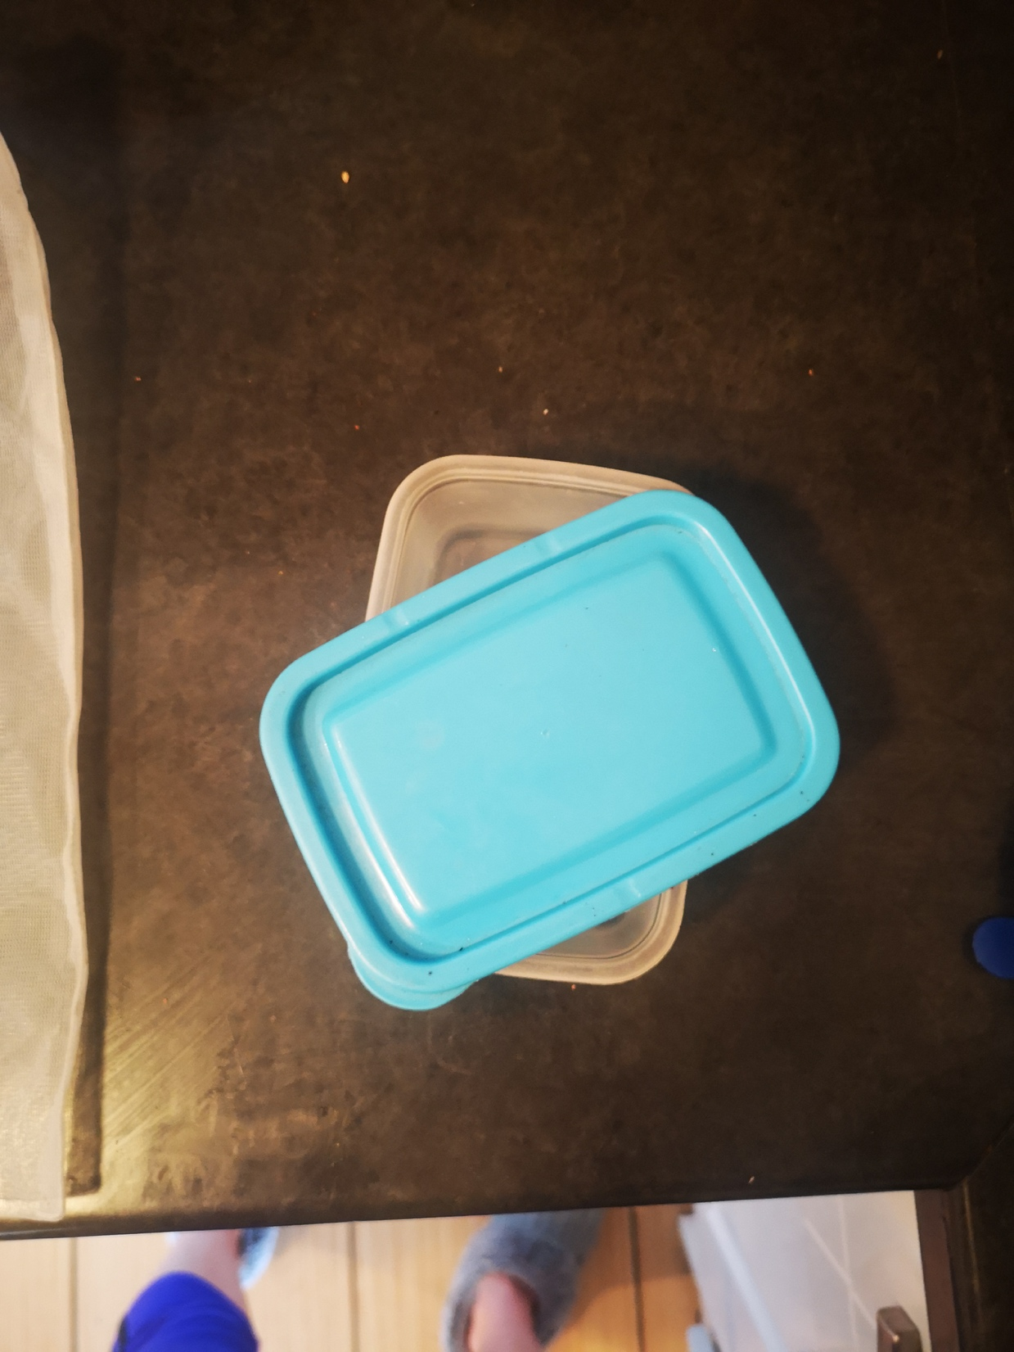
Review, think, talk….
Logo for section to sit inside roundel
How are materials used to fit a purpose? (20 minutes)
Activity 4:
Discuss:
Apart from cling film, is there anything else used to wrap or keep food fresh?
What materials are they made from? “I found a food bag (recycled plastic), a food lid (plastic) and a Tupperware container (plastic).”
What properties do they have in common and what properties are different?
“The Tupperware plastic is rigid and translucent. The lid and bag are also translucent but the lid is flexible and stretchy compared to the Tupperware.”
I can identify materials.
Help your child to identify the objects based on their materials and group them.
Compare and identify objects that have the same job. This could be toys, cutlery, chairs - anything!
Discuss:
The materials they are made from.
What properties they have in common and what properties are different.
7

Slide 8
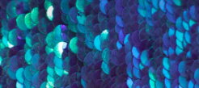
Review, think, talk….
Logo for section to sit inside roundel
Use materials to suit a specific purpose (30-40 minutes)
Activity 5:
You are learning from home and need a ‘uniform’ that is comfortable but also suitable for your daily exercise.
Think about what your uniform needs to be:
Should it be soft, rough? What materials would be best? If you want to work out, what properties should the materials have?
What will it look like?
Ask your child to present their design and explain their reasoning.
Critique their design and ask questions.
e.g. “Will the reflective sequins be comfortable for exercise?” or “I like that you used stretchy material - why did you choose that?”
Using materials from around the home, ask your child to design a uniform and to explain why they have designed it this way. It does not have to be to scale - it can be designed on a toy doll or teddy. If you do not have spare materials around the house, your child can draw their design instead and label.
stretchy
soft
Reflective
(shiny)
fabric
Ask your child to give you a brief this time (e.g. waterproof hat, lid for a container, safety jacket for cycling). Present your ideas and let your child critique them.

Slide 9
Glossary of terms
Materials: Material is the matter from which a thing is or can be made.
Properties: A property of an object or material is a feature that makes it suitable for a particular use.
Absorbent: Absorbent materials are able to soak up liquid easily.
Opaque: Light cannot pass through opaque material - you cannot see through it.
Transparent: Light can pass through transparent material - you can see through it.
Translucent: Some light can pass through translucent material so you can see a little bit through it.
Rigid: A rigid object or material cannot be easily bent out of shape.
Flexible: A flexible object or material can be bent easily without breaking.
Reflective: Light bounces off reflective material making it bright or shiny.
Dull: A dull object or material is not bright or shiny.
9

